Slide 1
Fulton’s K stuff

Slide 2
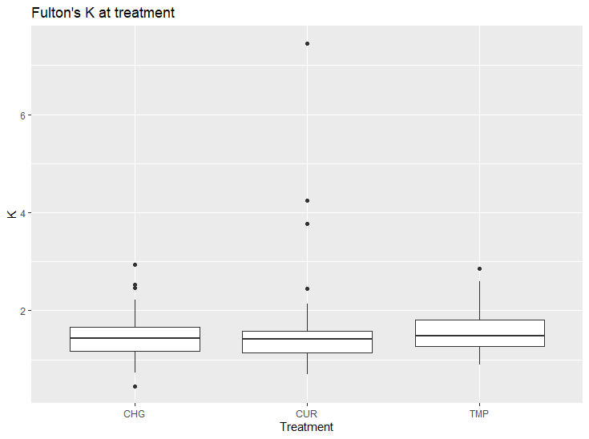
Most basic boxplot

Slide 3
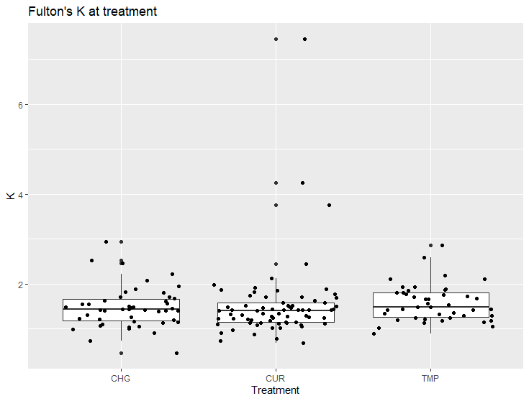
Basic boxplot + jitter

Slide 4

Notched boxplot, no jitter

Slide 5
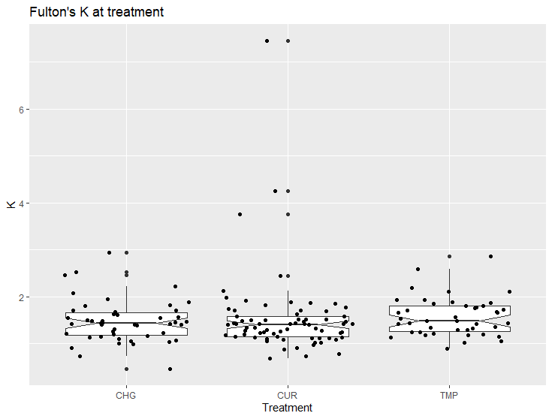
Notched boxplot + jitter

Slide 6
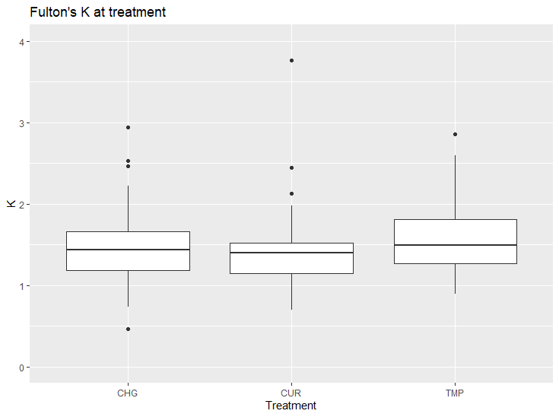
Basic boxplot, no outliers

Slide 7
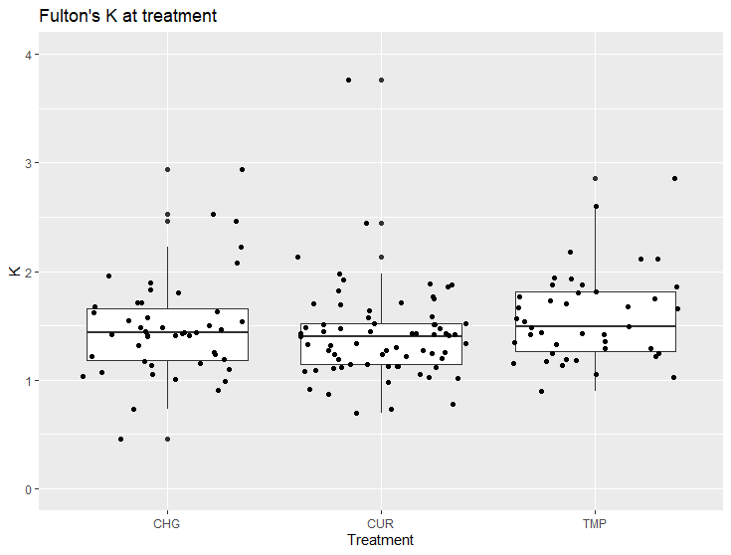
Boxplot + jitter, no outliers

Slide 8

Notched, no jitter, no outliers

Slide 9
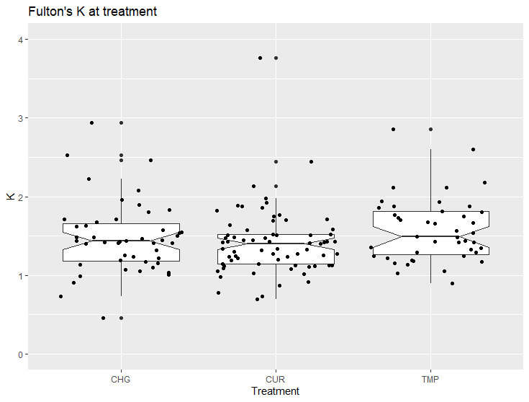
Notched + jitter, no outliers

